Slide 1
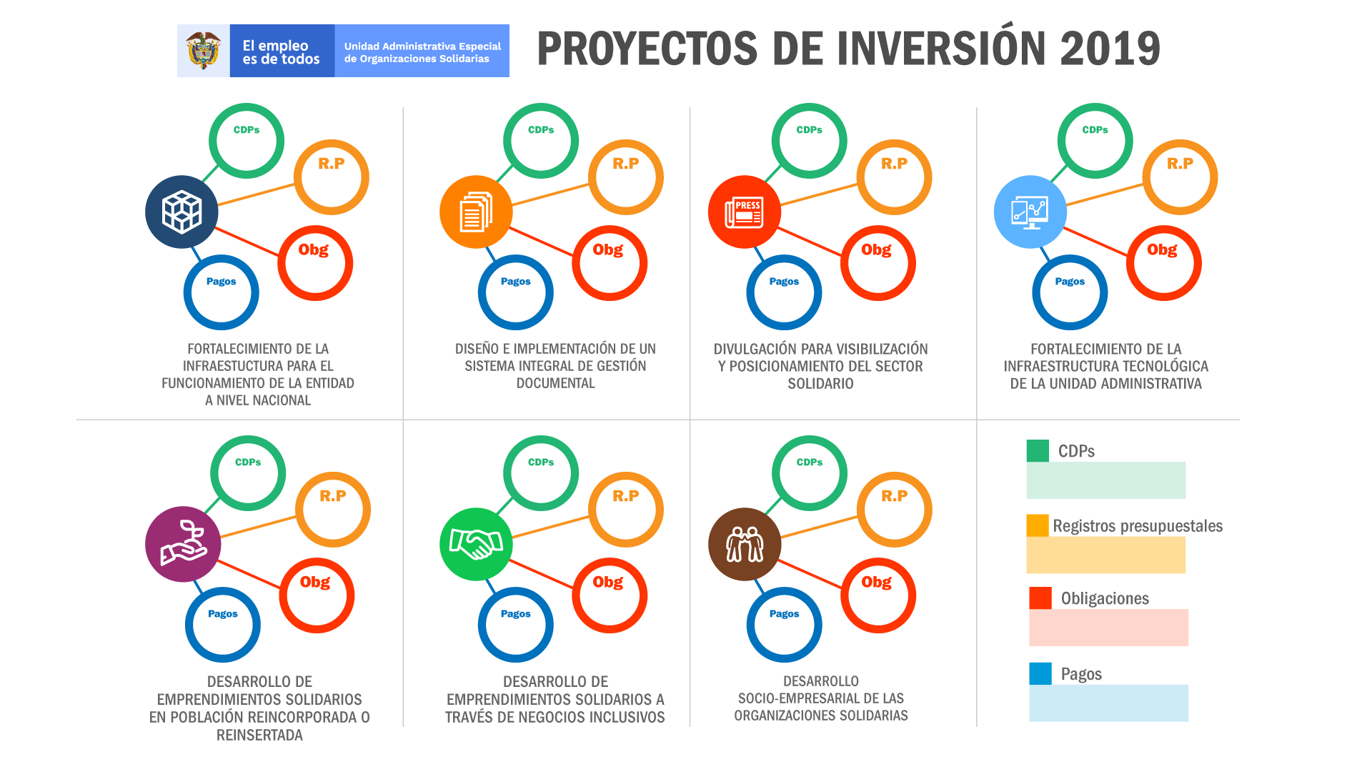
99,73%
99,53%
100%
99,14%
82,31%
99,53%
100%
87,15%
11,44%
90,74%
66,46%
58,97%
11,44%
90.74%
66,46%
58,97%
100%
100%
100%
99,94%
100%
100%
99,98%
98,97%
99,33%
78,66%
83,43%
99,33%
78,66%
83,43%
79,56%
79,54%

