Slide 1
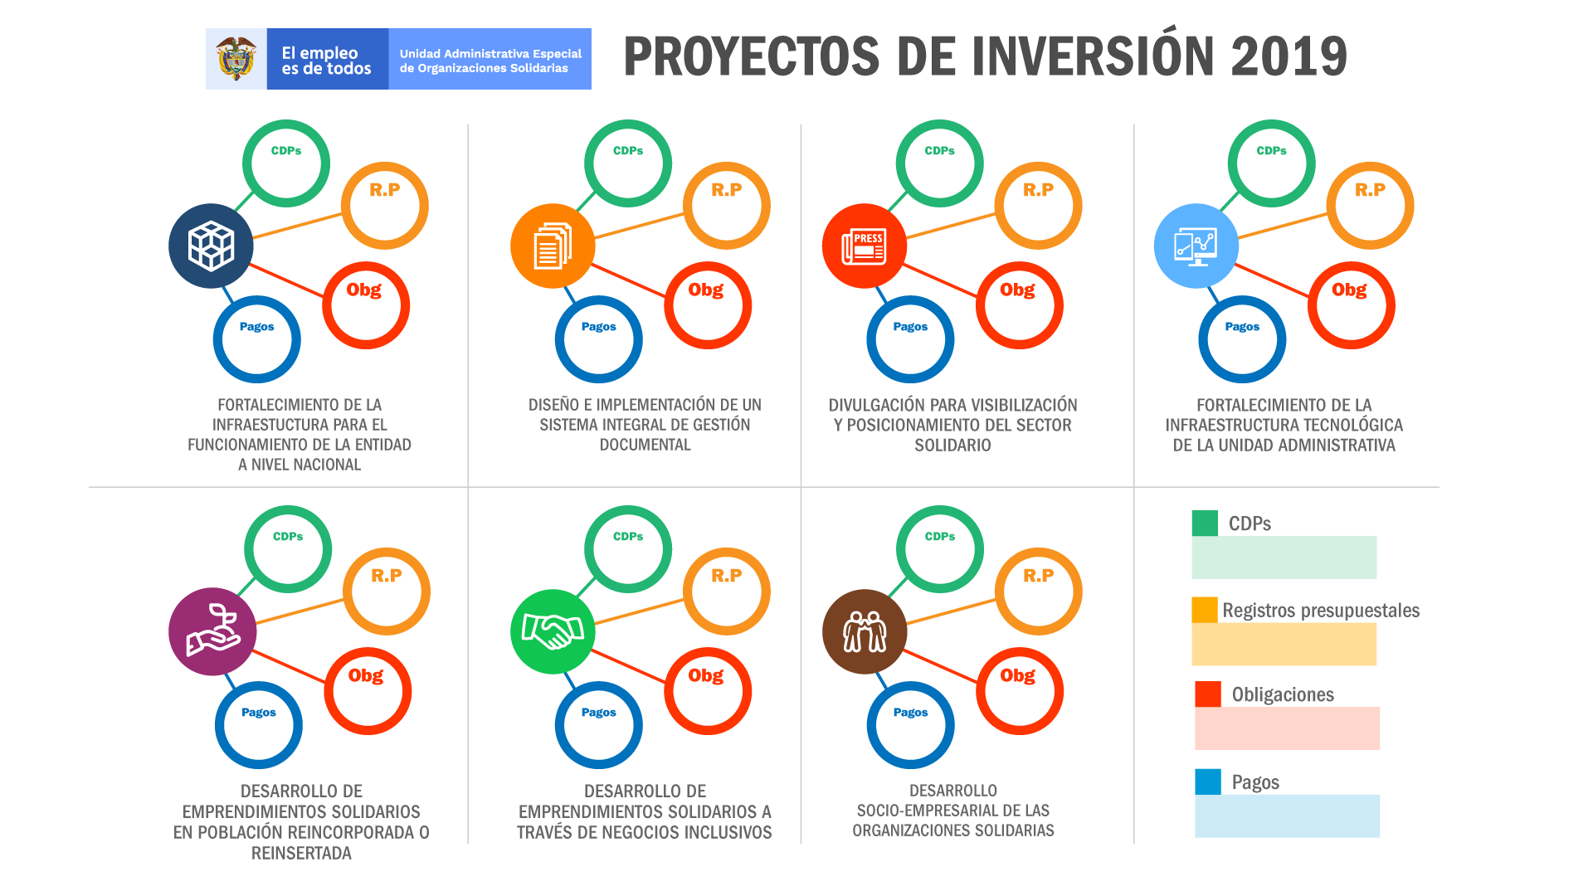
15,73%
99,53%
100%
84,76%
15,73%
99,53%
100%
54,57%
7,15%
52,30%
26,53%
14,94%
7,15%
52,30%
26,53%
14,94%
100%
100%
98,49%
96,22%
100%
97,89%
97,57%
93,85%
50%
39,88%
41,73%
50%
39,88%
41,64%
39,18%
39,12%

